Slide 1
Chord Recognition
Mattia lecci
Federico mason
Victor Cercos Llombart

Slide 2

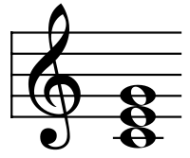
Chord Recognition: The problem

Slide 3
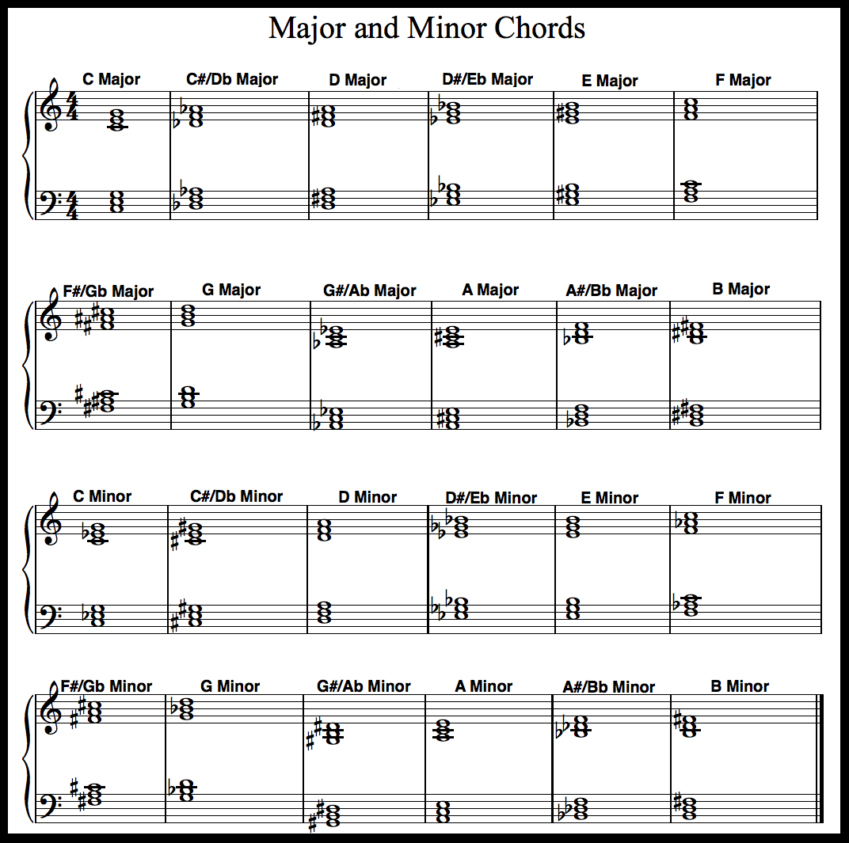
Chord Recognition: Interests
Accesible to non professionals
Automatizes long and boring process
At basis of high level music application

Slide 4
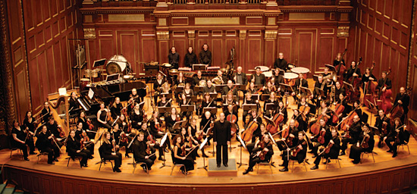
Chord Recognition: Difficulties
Ambiguos chords
Noise and missing notes
Indipendence from timbre and octave

Slide 5

Methodology

Slide 6
Flow chart
Audio File
Feature Extraction
Pattern Recognition
Chord Classification

Slide 7
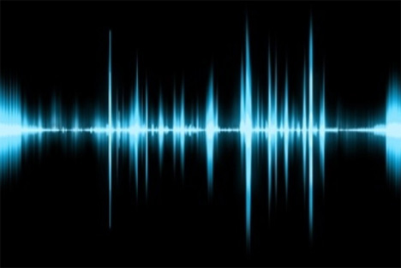
Audio file
4 different instruments
100 samples per chord
1 chord per music file
Both minor and major triads
http://www.montefiore.ulg.ac.be/services/acous/STSI/file/ jim2012Chords.zip

Slide 8
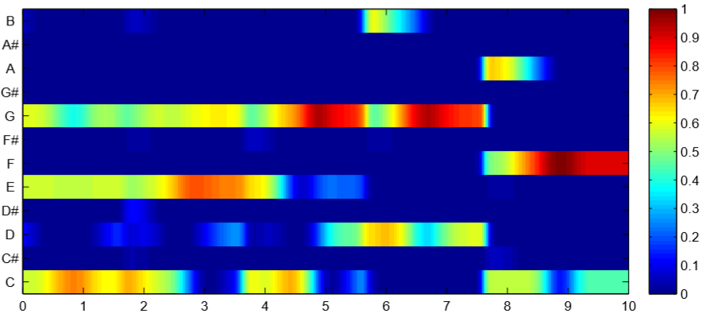
Feature Extraction
CLP: Chroma Features with Logarithmic Compression
CENS: Chroma Energy Normalized Statistics
CRP: Chroma DCT-Reduced log Pitch
http://resources.mpi-inf.mpg.de/MIR/chromatoolbox/

Slide 9
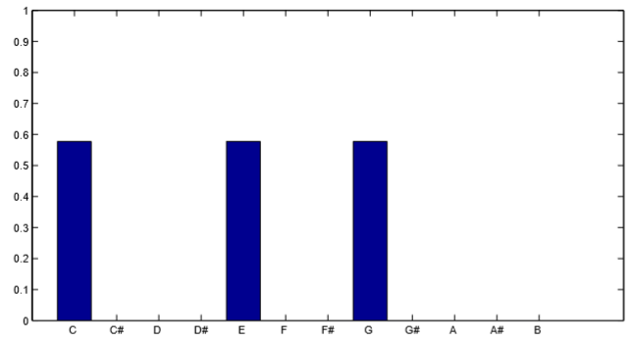
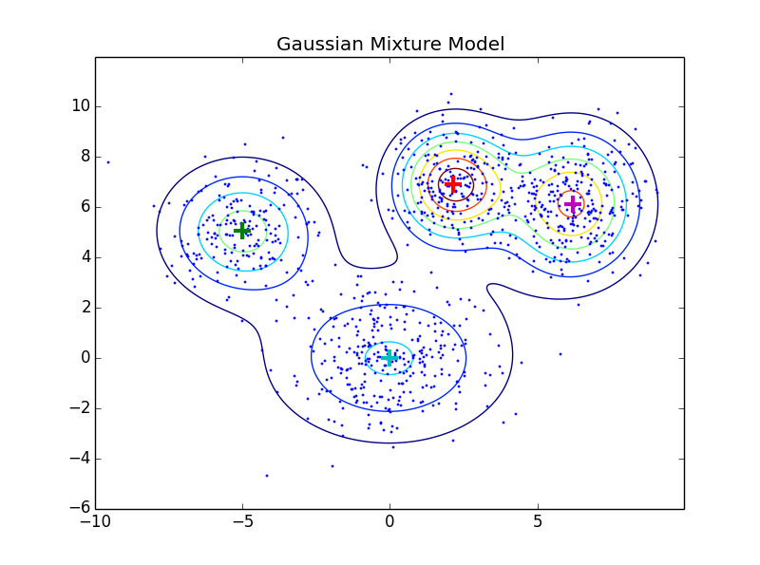
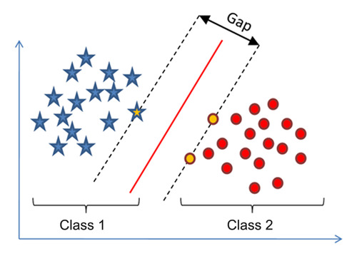
Pattern Recognition
TEMPLATE BASED
Binary templates
Harmonically enriched templates
STATISTICAL BASED
Gaussian mixture
SVM (Support Vector Machine)

Slide 10

Chord Classification
Only major and minor triads
Comparison of features
Comparison of models
Comparison of kernels (SVM)

Slide 11
MILESTONES
Proposal Presentation
First Prototype
Final Code
Final Paper
Final Presentation
Feature Extraction completed
Pattern Recognition completed
20/12
13/12
22/11
08/11
01/11
18/10
04/10

Slide 12

Thanks for your attention

